Slide 1
Xin Tang
My journey from 1 to 21

Slide 2

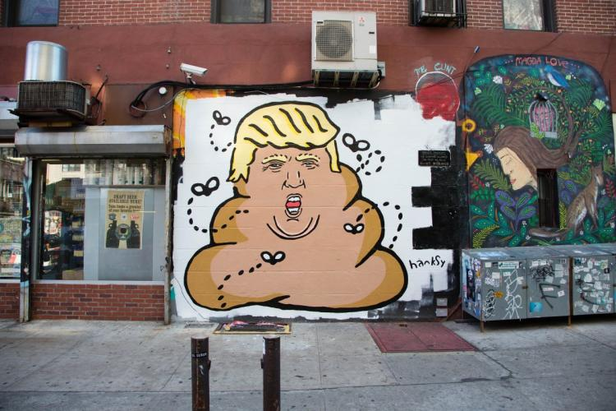
At age of 3:
From Rags to riches
At the age of 4, I immigrated from Hong Kong to NYC. Honestly life was different. In Hong Kong, life was sweet. I live the life of upperclassmens. I live in a beautiful suite in the one of the tallest building in hong kong. I had my own maid and butler that carry to all my request. I had all the toys a kid can ask for. I had a different dishes prepared for me everyday. I was living big. Then one day, life changed. My parents had decided to move to America. Just like that I went from pent house suite to 2 bedroom apartment in lower east side, from 5-star meals to leftover, and from a house full of toys to books. This was dream right. Nope this was now my life now.

Slide 3

At age 4
English?? 嗯么是 English??
At age 4,I was living in a city full of places I never been, people I never seen, and lastly a language I never spoke. As I walk into my first day of kingergarden, I scream at my teacher “What are you saying, speak Chinese why wont you???”in Chinese of course. The teacher look at me and said “this is America, you need to learn how to speak English”. “English, what is English??” as i wonder while scratching my head cluelessly.

Slide 4

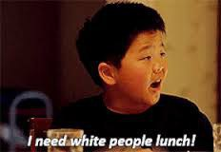
At age 6:
“Speak English chick”
At age 6, I attended elementary school. Now starting school with classroom full of native speaking student is hard. Now being one of the only Asian kid in class that barely spoke English means your fu**ked!!!! Constantly I was bullied for being Asian.

Slide 5


Ata ge 13:
496
At age 14, I was studying for this exam called the SHSAT, it know as the specialized high school where students in new York City study for this exam to make it to the “Best school in the city”. On top of the top ranking list was stuyevesant HS. The greatest high school in new York city with the accepted score of 550 out of 700. I study kinda hard for it for someone who normally never studies for anything. The big day came and I took it. But the result wasn’t what I wanted. I was only able to score 496 and was not accepted to stuy. That was a depressing day

Slide 6
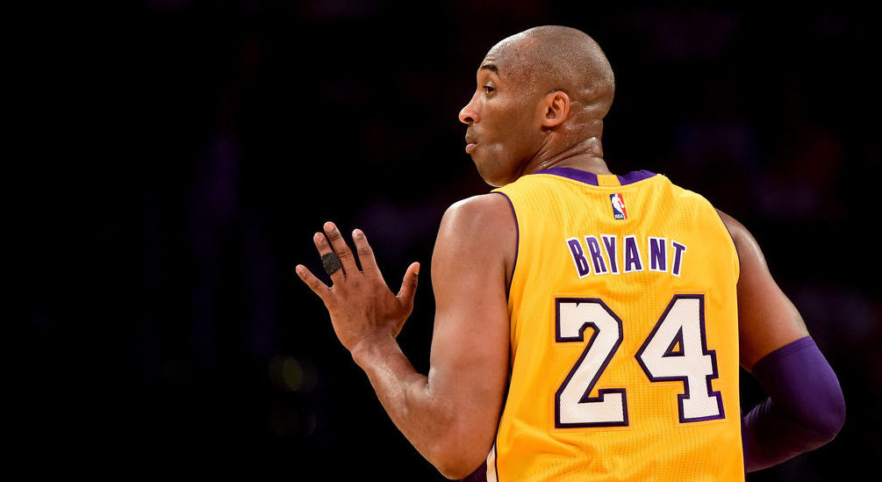
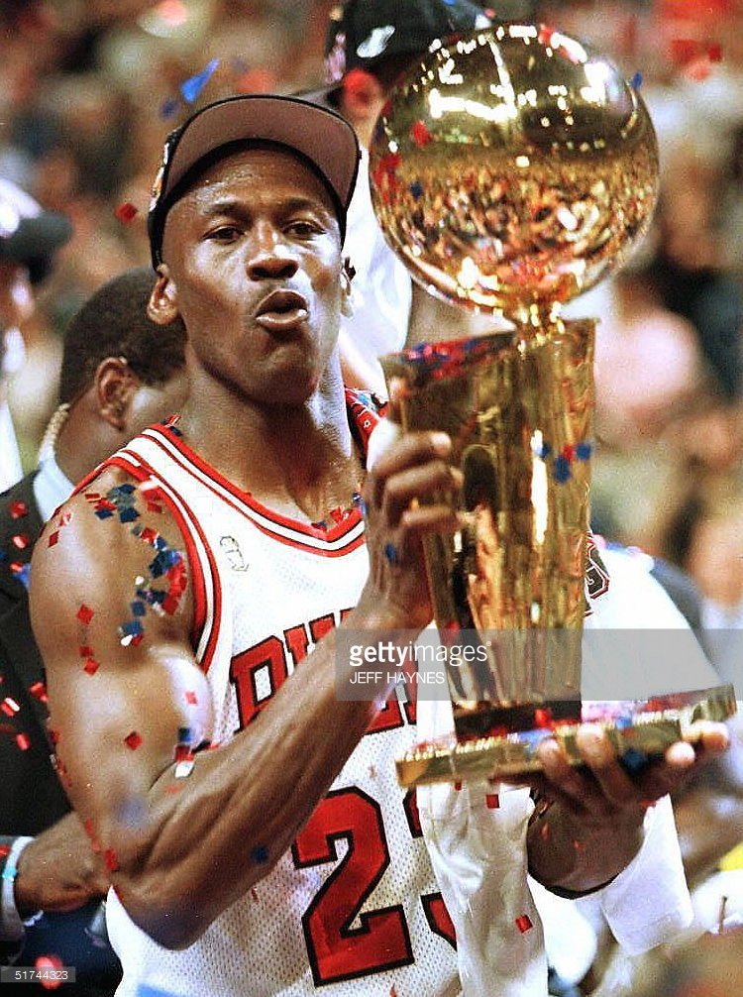
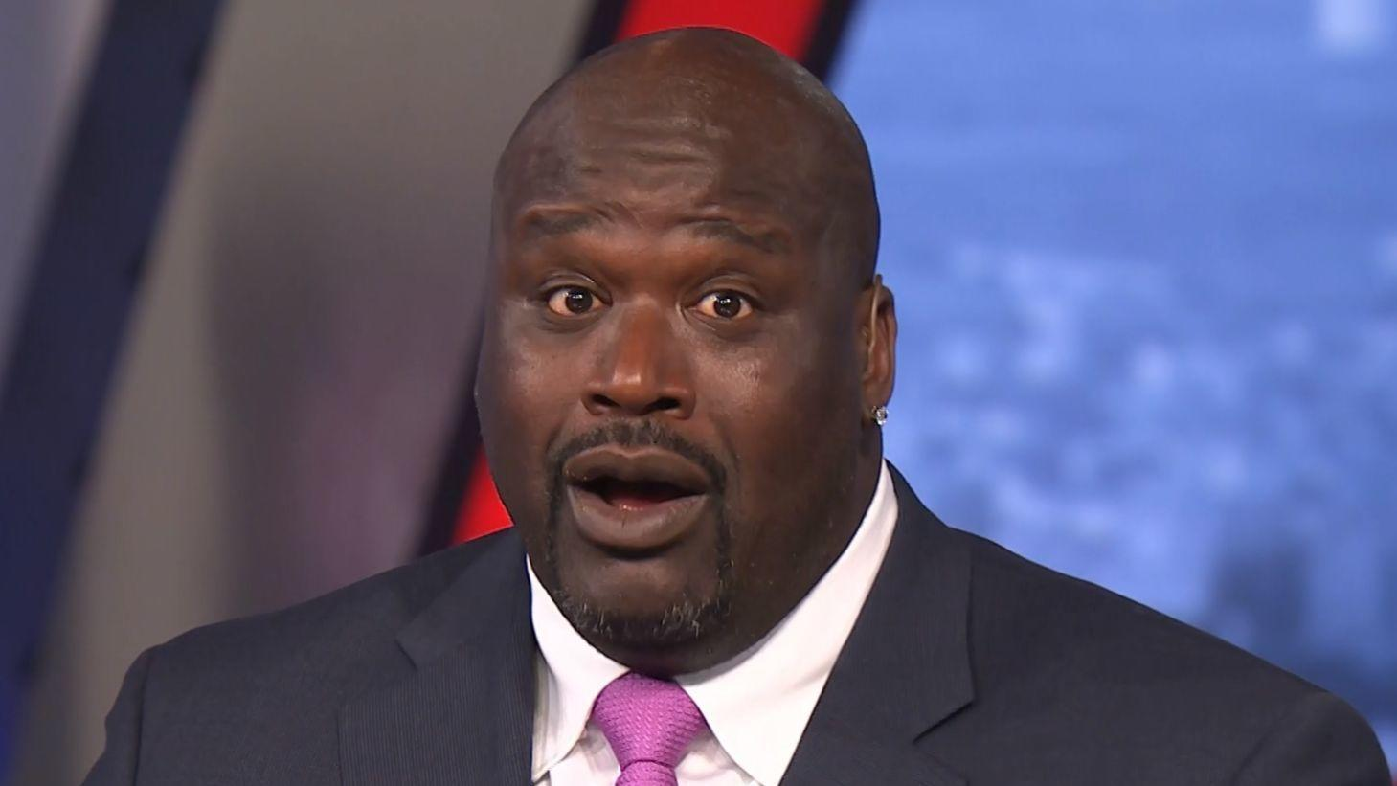
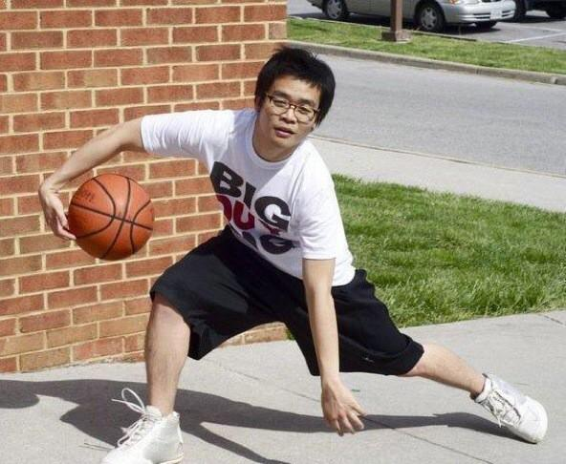
At Age 15:
Ball is Life
At young, I always loved basketball. I wanted to be one of the great SHAQ, MJ, Magic ,or KOBE. SO I tried out for the basketball team and I thought I was gonna make it. But when the list came out for the JV. My name aint on it.

Slide 7

At age of 18
“I aint cluth”
At the age of 16, I made the my HS basketball team and have been playing on it for 2 years now.I was starting in the lineup and it was first we made it to playoff in a while. Now we were playing against another team and the scorce was close. We were down by 2 and I just caught the rebound. With 10 sec on the clock, I shoot it thinking I can win the game for us. I could been like MJ, or Kobe but I missed and we lost.

Slide 8

At age of 20
“dumped”
At the age of 20, I got dumped by girl I was dating. Normally never being the one dumped, I idiotically ask her out again. This time, she didn’t replay and her friend texted me instead saying she not interested. Oooohhhhh ouch!!!!

Slide 9
NOW YOU MAY ASK WHO ARE U NOW????
Well, I am a lot of things.

Slide 10

I am the 3 year old spoil brat who complainS a lot

Slide 11

I am the 4 year kid who didn’t speak English

Slide 12

I am the 7 year old boy who got bullied in middle school

Slide 13
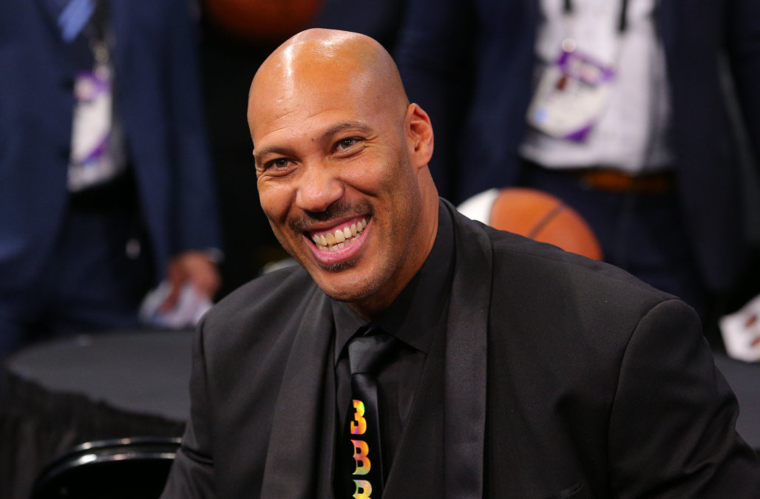
I am the 15 and 18 year old teen who cant play basketball

Slide 14

I am 20 year old who got dumped twice by the same girl

Slide 15

I am 21 now
I am 21 years old now, and I am all those things and more. I faced a lot of hardship and failed more times that I can count but the real me is the one able to stand up from those failure. Failure is success if we learn from it. – Xin Tang

